Slide 1






Mahmoud Amer
ELT PIPELINE
PROJECT
Project Guidelines

Slide 2


DEFINITION AND STEPS
Table of Contents
Project Overview
Objectives
Data Description
ETL Pipeline Steps
Visualizations and Analysis
Challenges and Solutions
Key Outcomes
Future Enhancements
Appendix

Slide 3

PROJECT OVERVIEW
Summary
Streamlining data processing and storing clean data for analytics
Tools and technologies used - Docker / Python / SQL
The ETL project under our hands gives a clear approach on to how to process / clean / Extract data From Different sources - CSVs / API - and apply the full ETL Process

Slide 4

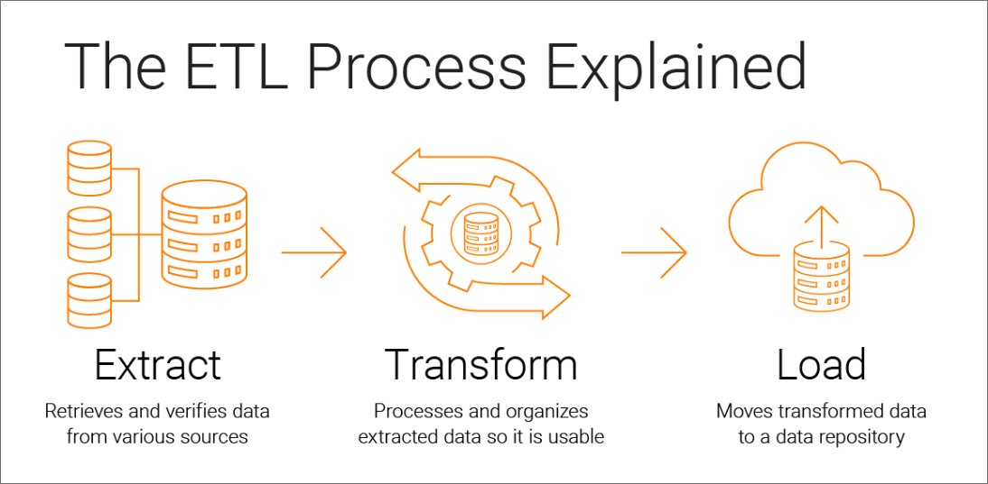
LANGUAGES
OBJECTIVES
Automate data extraction from multiple sources.
Clean and prepare data for analysis.
Store data in a centralized database (Data Warehouse).
Provide actionable insights using visualizations.

Slide 5
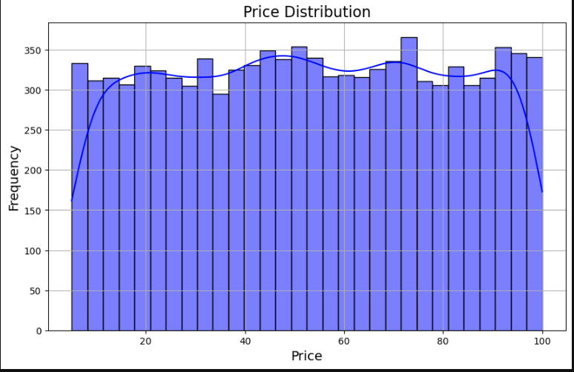
DATA DESCRIPTION
Content :
Columns in the dataset (e.g., id, name, quantity, price, etc.).
Data size (10,000 records) and type (CSV).
Highlight challenges like null values and outliers.

Slide 6




ETL PIPELINE STEPS
EXTRACTION
TRANSOFRMATION

Slide 7
ETL PIPELINE STEPS : EXTRACTION
THERE WERE MULTIPLE RESOURCE TO PULL THE DATA FROM , THE BEST APPROACH FOR OUR CASE WAS TO GENRETAE DATA , AS MOST OF THE AVAILABLE WE ALREADY CLEANED
THE DATA WE HAVE IS OF SIZE 10,000 ROWS , INCLUDES CATEGORIES , PRODUCTS AND TIME STAMP FOR SALE
THE DATA IS PROVIDED BELOW :
LINK TO DATA - IN CSV FORMAT

Slide 8
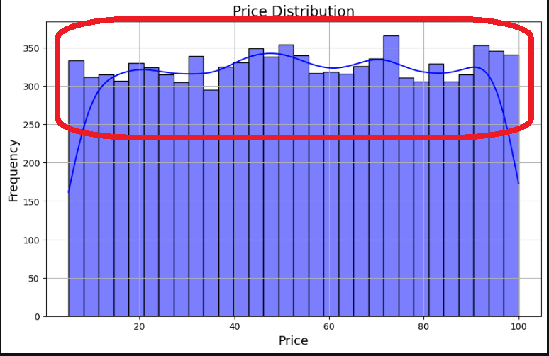
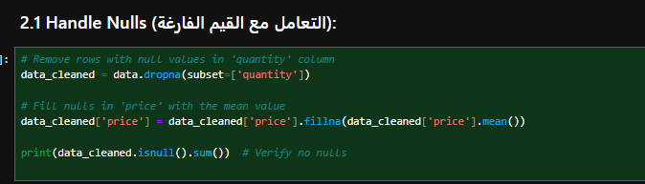
ETL PIPELINE STEPS : TRANSFORMATION
CLEANING STEPS :
REMOVING OULTIERS
HANDELING NULLS

Slide 9
ETL PIPELINE STEPS : LOADING
POSTGRESQL SETUP (E.G., DATABASE NAME, SCHEMA).
Number of rows successfully loaded.
SQL queries used for validation

Slide 10
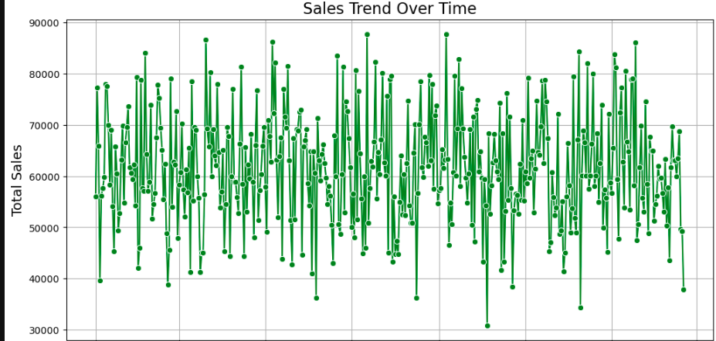
VISUALIZATIONS AND ANALYSIS
SALES TREND OVER TIME
CHART SHOWING DAILY/WEEKLY SALES TRENDS.

Slide 11
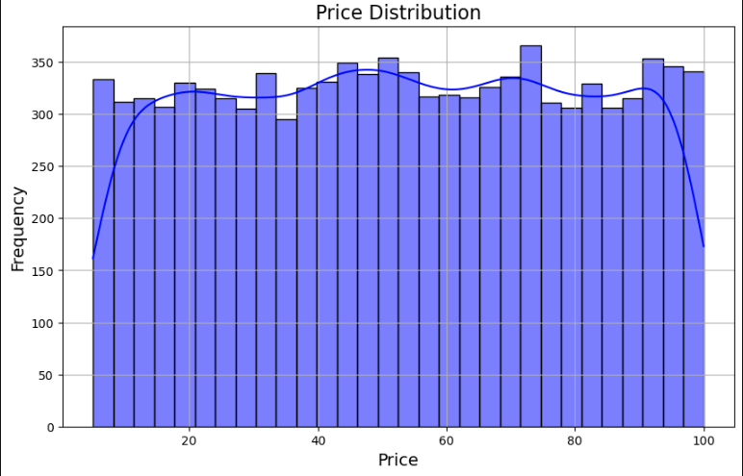
VISUALIZATIONS AND ANALYSIS
DISTRIBUTION OF PRICES

Slide 12




FUTURE ENHANCEMENTS
Adding real-time data streaming using Apache Kafka.
Implementing Airflow for ETL scheduling and automation.
Expanding the pipeline to include APIs or larger datasets.

Slide 13



THANK YOU!
+201008504925
mahmoud1234amer@gmail.co

